Slide 1

FOL Inferencing
$$∀x \left( ∃y \left(P\left(x\right)∧¬\left(Q\left(x,y\right)∨R\left(f\left(x\right),f\left(y\right)\right)\right) \right)⇒S\left(x\right)\right)$$
…
…
$$KB⊨α ?$$

Slide 2
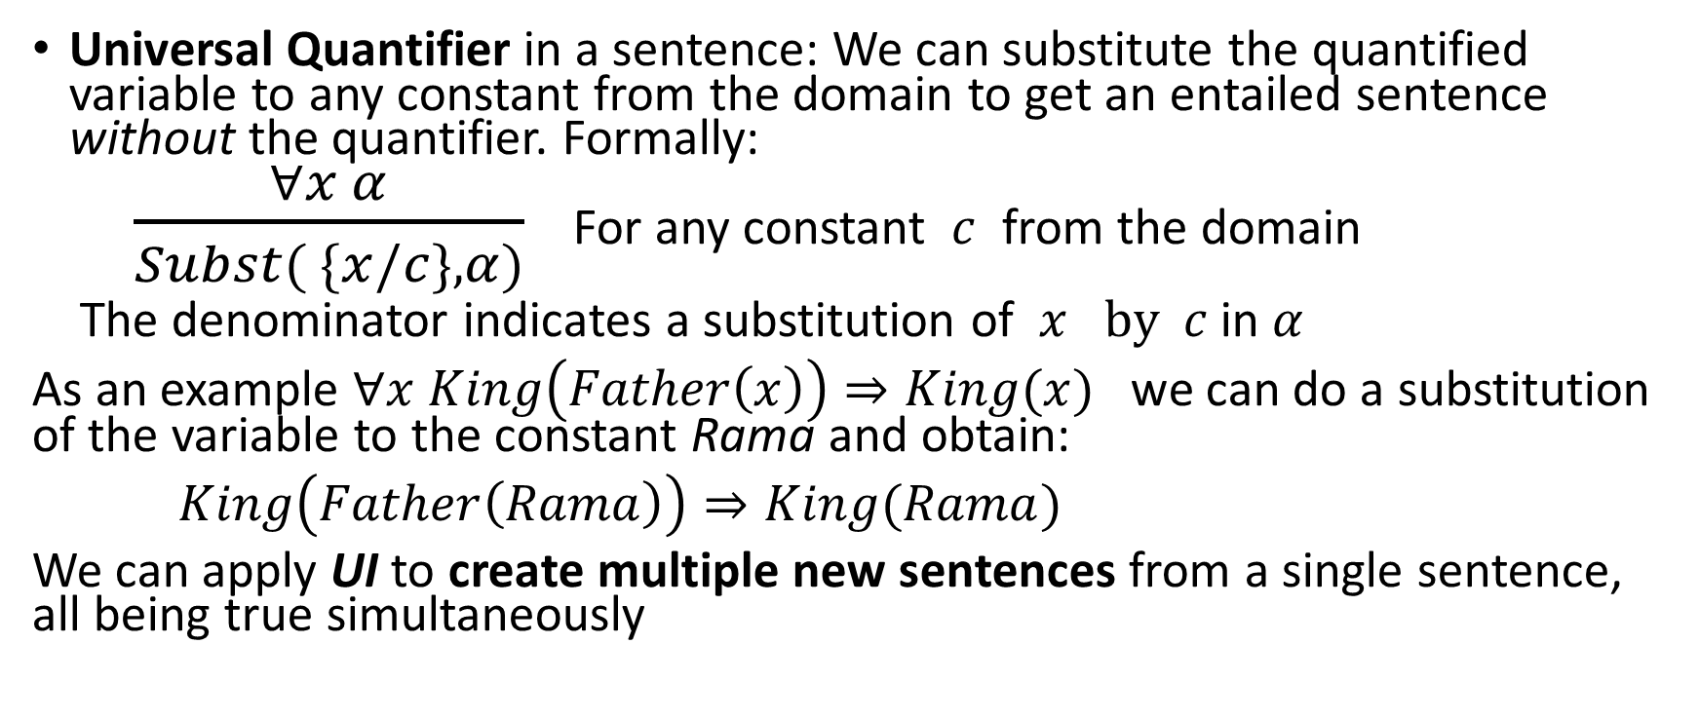
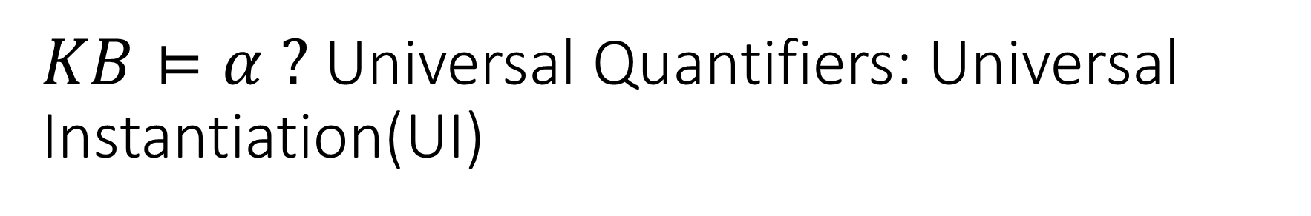
$KB⊨α ?$Universal Quantifiers: Universal Instantiation(UI)
Universal Quantifier in a sentence: We can substitute the quantified variable to any constant from the domain to get an entailed sentence without the quantifier. Formally:
$\frac{∀x α}{Subst( \{x/c\},α)}$ For any constant $c$ from the domain
The denominator indicates a substitution of $x by c$ in $α$
As an example $∀x King\left(Father\left(x\right)\right)⇒King(x)$ we can do a substitution of the variable to the constant Rama and obtain:
$King\left(Father\left(Rama\right)\right)⇒King(Rama)$
We can apply UI to create multiple new sentences from a single sentence, all being true simultaneously

Slide 3
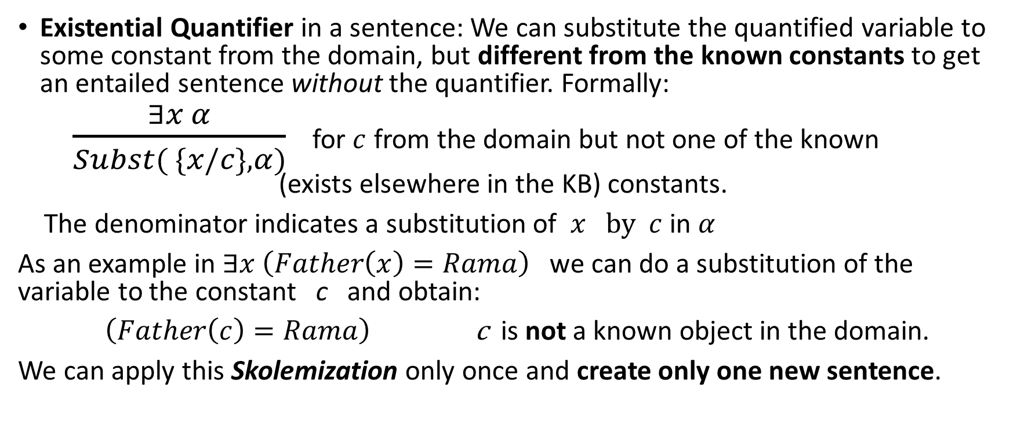
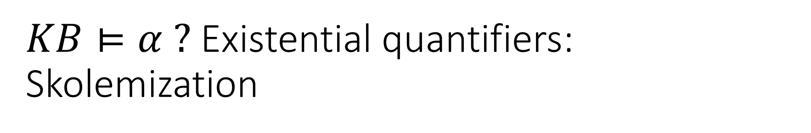
$KB⊨α ?$ Existential quantifiers: Skolemization
Existential Quantifier in a sentence: We can substitute the quantified variable to some constant from the domain, but different from the known constants to get an entailed sentence without the quantifier. Formally:
$\frac{∃x α}{Subst( \{x/c\},α)}$ for $c$ from the domain but not one of the known (exists elsewhere in the KB) constants.
The denominator indicates a substitution of $x by c$ in $α$
As an example in $∃x \left(Father\left(x\right)=Rama\right)$ we can do a substitution of the variable to the constant c and obtain:
$\left(Father\left(c\right)=Rama\right)$ c is not a known object in the domain.
We can apply this Skolemization only once and create only one new sentence.

Slide 4
Propositionalization approach to inferencing in FOL

Slide 5
Propositionalization
An arbitrary sentence without quantifiers only has constants and functions on them.
Ones with quantifiers we can apply UI to create all possible sentences from a given one or Skolemization to create one new sentence. After that we remove the quantified sentences.
Now we have propositionalized the entire KB because we don’t have any variables anywhere at all, but we have all the knowledge in the form of propositions.
At this point we may apply all rules of inference we learnt from PL.
One catch exists with functions, which can be applied infinitely many times.
However we can apply this a finite number of times and use a PL inference method in that. If we don’t have an entailment, we can try the next iteration.

Slide 6
Decidability
The propositionalization method is indeed complete. Every entailed sentence is derivable.
However we can never use that to decide if a sentence is not entailed.
We say that entailment in FOL is semi-decidable.
(‘yes’ instances have derivations, or proofs. ‘no’ instances don’t!)

Slide 7
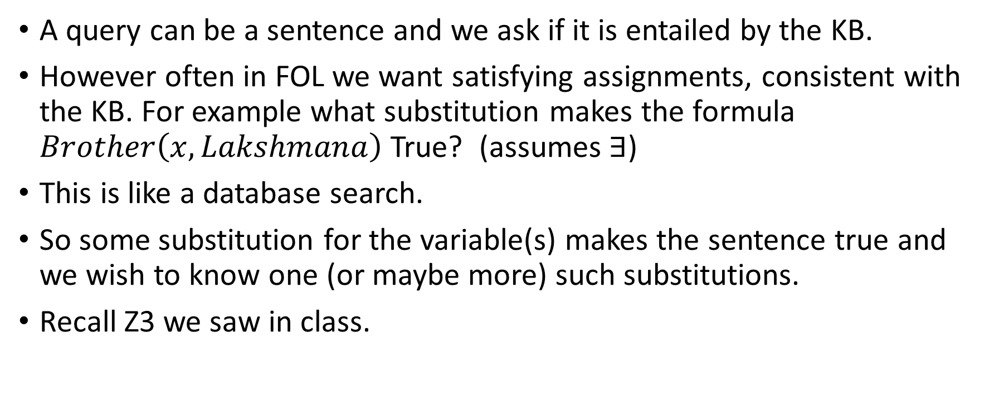
Query in FOL
A query can be a sentence and we ask if it is entailed by the KB.
However often in FOL we want satisfying assignments, consistent with the KB. For example what substitution makes the formula $Brother\left(x, Lakshmana\right)$ True? (assumes $∃$)
This is like a database search.
So some substitution for the variable(s) makes the sentence true and we wish to know one (or maybe more) such substitutions.
Recall Z3 we saw in class.

Slide 8
Staying in FOL and finding inference methods (without propositionalization)

Slide 9
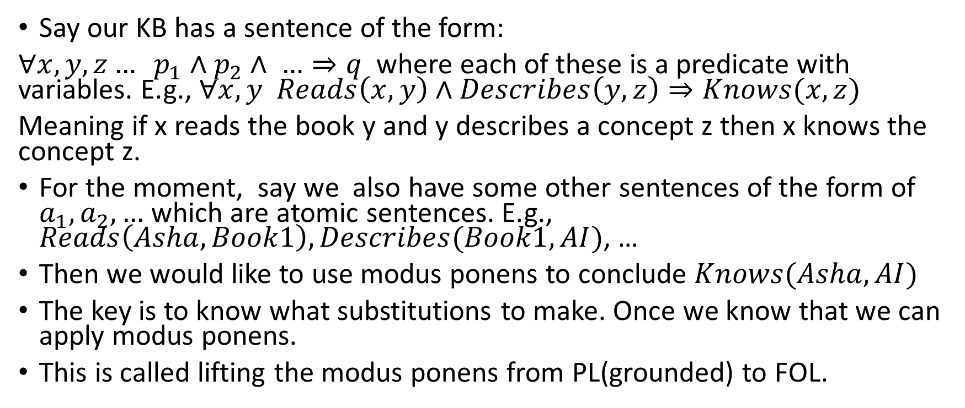
Modus Ponens in FOL
Say our KB has a sentence of the form:
$∀x,y,z… p_{1}∧p_{2}∧ …⇒q$ where each of these is a predicate with variables. E.g., $∀x,y Reads\left(x,y\right)∧Describes\left(y,z\right)⇒Knows(x,z)$
Meaning if x reads the book y and y describes a concept z then x knows the concept z.
For the moment, say we also have some other sentences of the form of $a_{1}, a_{2},…$ which are atomic sentences. E.g., $Reads\left(Asha,Book1\right), Describes(Book1,AI)$, …
Then we would like to use modus ponens to conclude $Knows(Asha,AI)$
The key is to know what substitutions to make. Once we know that we can apply modus ponens.
This is called lifting the modus ponens from PL(grounded) to FOL.

Slide 10
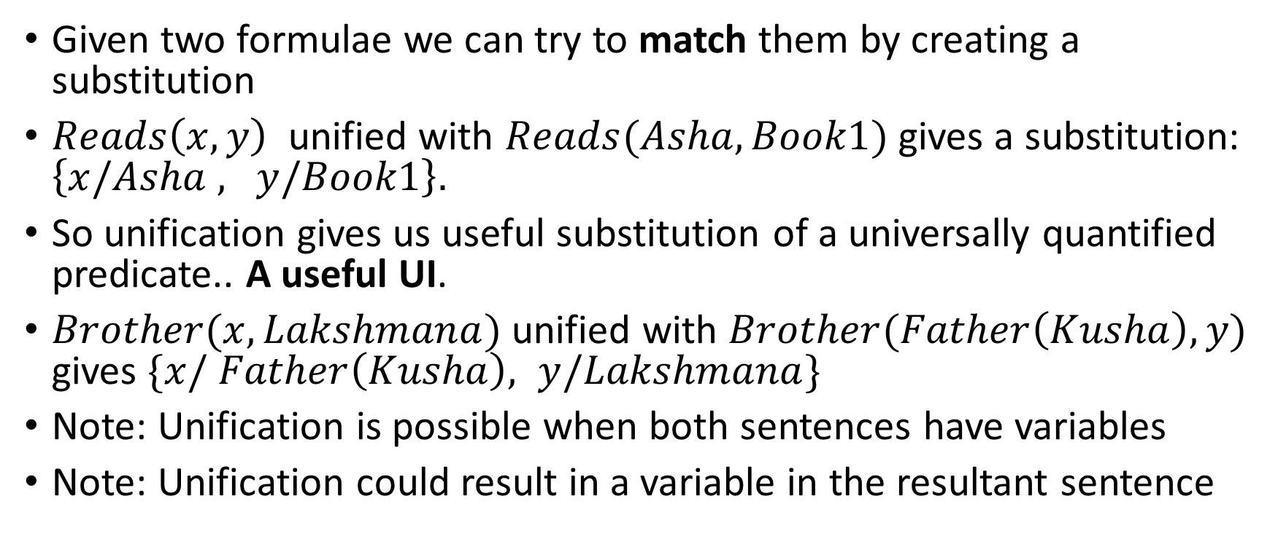
Unification – a process to create substitutions
Given two formulae we can try to match them by creating a substitution
$Reads\left(x,y\right)$ unified with $Reads(Asha,Book1)$ gives a substitution: $\left\{x/Asha , y/Book1\right\}.$
So unification gives us useful substitution of a universally quantified predicate.. A useful UI.
$Brother(x,Lakshmana)$ unified with $Brother(Father\left(Kusha\right),y)$ gives $\{x/ Father\left(Kusha\right), y/Lakshmana\}$
Note: Unification is possible when both sentences have variables
Note: Unification could result in a variable in the resultant sentence

Slide 11
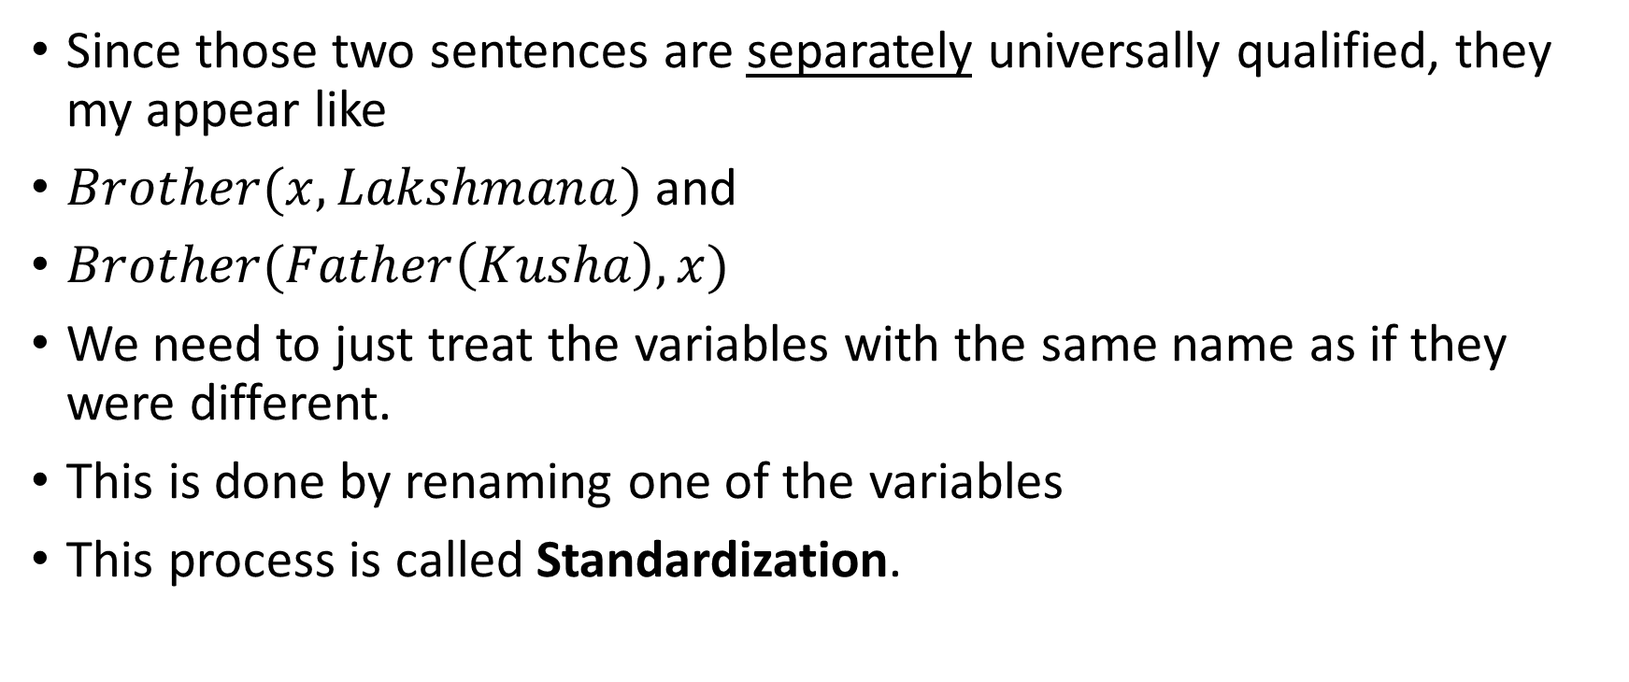
Standardization
Since those two sentences are separately universally qualified, they my appear like
$Brother(x,Lakshmana)$ and
$Brother(Father\left(Kusha\right),x)$
We need to just treat the variables with the same name as if they were different.
This is done by renaming one of the variables
This process is called Standardization.

Slide 12
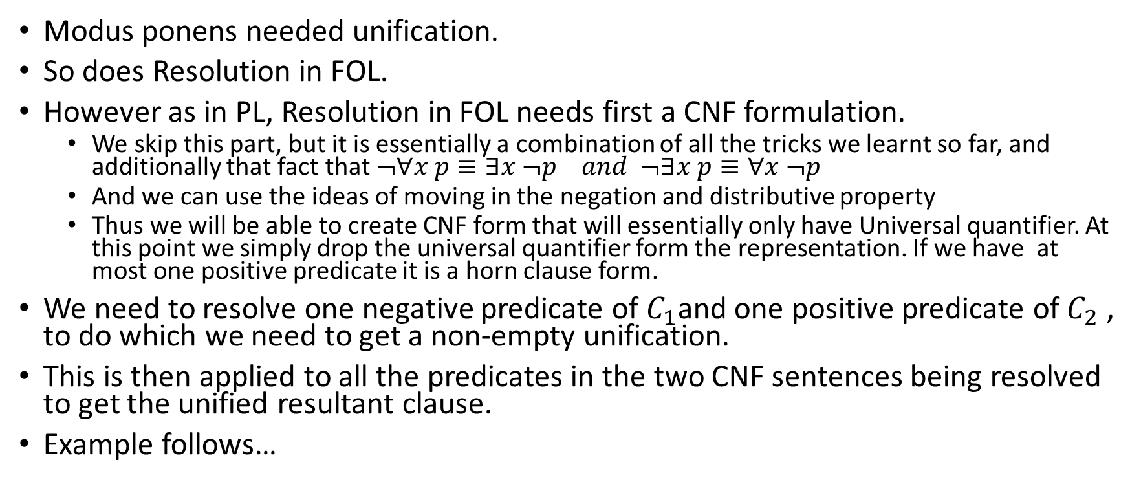
Resolution in FOL
Modus ponens needed unification.
So does Resolution in FOL.
However as in PL, Resolution in FOL needs first a CNF formulation.
We skip this part, but it is essentially a combination of all the tricks we learnt so far, and additionally that fact that $¬∀x p≡∃x ¬p and ¬∃x p≡∀x ¬p$
And we can use the ideas of moving in the negation and distributive property
Thus we will be able to create CNF form that will essentially only have Universal quantifier. At this point we simply drop the universal quantifier form the representation. If we have at most one positive predicate it is a horn clause form.
We need to resolve one negative predicate of $C_{1}$and one positive predicate of $C_{2}$ , to do which we need to get a non-empty unification.
This is then applied to all the predicates in the two CNF sentences being resolved to get the unified resultant clause.
Example follows…

Slide 13
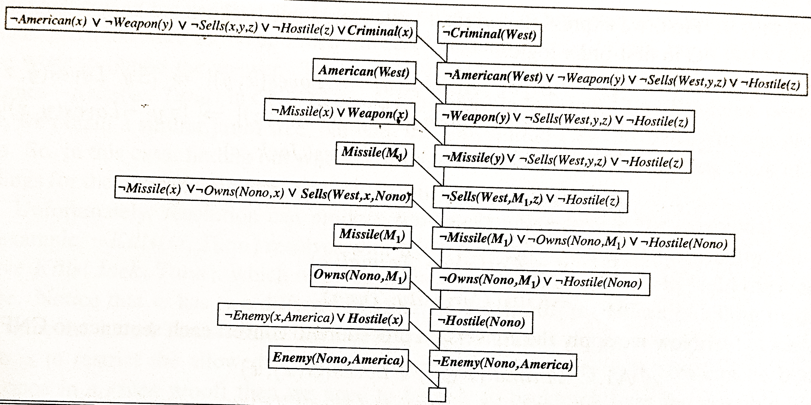

A Resolution Proof of $Criminal(West)$ [Fig 9.11]

